Slide 1
DATABASE DAY-4

Slide 2
Degree Of Relationship
Relationships define how tables are connected through primary and foreign keys. The degree (or type) of relationship tells us how many records in one table are related to records in another.
One-to-One (1:1)
Definition: One record in Table A is related to exactly one record in Table B.
Person (parent)
person_id PK | name | date_of_birth
1 | Alice | 1995-03-12
2 | Bob | 1990-07-25
Passport (child)
passport_id PK | person_id FK→Person.person_id | issue_date
P-1001 | 1 | 2022-05-10
P-1002 | 2 | 2021-11-18

Slide 3
One-to-Many (1:N)
Definition: One record in Table A is related to many records in Table B.
Example:
One customer can place many orders
Each order belongs to one customer
Most common relationship type
One-to-Many (1 : N) — Customer → Orders
Customer (parent)
customer_id PK | name
10 | Alice
11 | Bob
Orders (child)
order_id PK | customer_id FK→Customer.customer_id | date | amount
5001 | 10 | 2025-05-10 | ₹1 200
5002 | 10 | 2025-05-12 | ₹ 650
5003 | 11 | 2025-05-13 | ₹2 050

Slide 4
Many-to-One (N:1)
Definition: Many records in Table A relate to one record in Table B.
This is basically the reverse of One-to-Many
Many orders can belong to one customer
Practically the same as 1:N, just viewed from the child table side.
A single customer can place many orders; each order belongs to one customer.
Orders (many)
order_id PK | customer_id FK→Customer.customer_id | date | amount
5001 | 10 | 2025-05-10 | ₹1 200
5002 | 10 | 2025-05-12 | ₹ 650
5003 | 11 | 2025-05-13 | ₹2 050
Orders (child)
order_id PK | customer_id FK→Customer.customer_id | date | amount
5001 | 10 | 2025-05-10 | ₹1 200
5002 | 10 | 2025-05-12 | ₹ 650
5003 | 11 | 2025-05-13 | ₹2 050

Slide 5
Many-to-One (N:1)
Definition: Many records in Table A relate to one record in Table B.
This is basically the reverse of One-to-Many
Many orders can belong to one customer
Practically the same as 1:N, just viewed from the child table side.
Many orders map back to a single customer.
Orders (many)
order_id PK | customer_id FK→Customer.customer_id | date | amount
5001 | 10 | 2025-05-10 | ₹1 200
5002 | 10 | 2025-05-12 | ₹ 650
5003 | 11 | 2025-05-13 | ₹2 050
Customer (one)
customer_id PK | name
10 | Alice
11 | Bob

Slide 6
A Many-to-Many relationship occurs when:
One record in Table A can be related to many records in Table B, and one record in Table B can be related to many records in Table A.
Example: Students & Courses
Scenario:
A student can enroll in many courses
A course can have many students
So we cannot store this directly using just two tables. We need a third table to connect them.
Student Table
student_id (PK) | name
101 | Alice
102 | Bob
103 | Carol
Courses Table
course_id (PK) | course_name
C1 | Database Systems
C2 | Web Development
C3 | Python Programming

Slide 7
Student_Courses Table (Join Table)
This third table is called a junction table or bridge table.
It breaks the many-to-many into two one-to-many relationships:
Students → Student_Courses
Courses → Student_Courses
student_id (FK) | course_id (FK)
101 | C1
101 | C2
102 | C1
103 | C1
103 | C3

Slide 8
JOINS
INNER JOINS
Returns only rows that have matching values in both tables.
students
student_id | name
1 | Raj
2 | Simran
3 | Ayaan
4 | Neha
enrollments
student_id | course
1 | Python
2 | Java
4 | Web Development

Slide 9
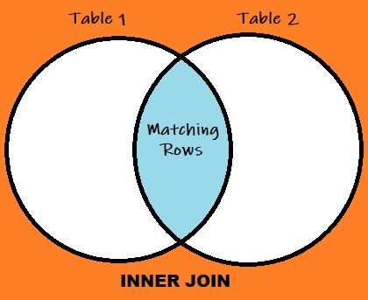
SELECT students.name, enrollments.course
FROM students
INNER JOIN enrollments ON students.student_id = enrollments.student_id;
Ignores unmatched rows.
Most commonly used join.
Result is usually smaller than the source tables.

Slide 10
TrainerID | Trainer | Course
1 | Abhinav | AI/ML
2 | Ashish | DS
3 | Srajan | DBMS/Data Analysis
StudentID | Name | TrainerID
1 | Ram | 1
2 | Mohan | 3
3 | Ravi | 2

Slide 11
TrainerID | Name | Course | StudentID | Name | CourseID
1 | Abhinav | AI/ML | 1 | Ram | 1
1 | Abhinav | AI/ML | 2 | Mohan | 3
1 | Abhinav | AI/ML | 3 | Ravi | 2
2 | Ashish | DS | 1 | Ram | 1
2 | Ashish | DS | 2 | Mohan | 3
2 | Ashish | DS | 3 | Ravi | 2
3 | Srajan | DBMS/Data Analysis | 1 | Ram | 1
3 | Srajan | DBMS/Data Analysis | 2 | Mohan | 3
3 | Srajan | DBMS/Data Analysis | 3 | Ravi | 2
TrainerID | Name | Course | StudentID | Name | TrainerID
1 | Abhinav | AI/ML | 1 | Ram | 1
2 | Ashish | DS | 2 | Mohan | 3
3 | Srajan | DBMS/Data Analysis | 3 | Ravi | 2

Slide 12
INNER JOINS TASKS
Show all student names with their trainer names.
List students and the courses they are enrolled in.
Show student name, course name, and trainer name.
Find which trainer is assigned to student 'Ram’.
Find which course 'Mohan' is learning.
Get the total number of students under each trainer.
Show all students learning from 'Ashish’.
List courses that have more than 1 student enrolled.
List student names and their Trainer IDs.
Show all student-trainer pairs where trainer teaches "DS".

Slide 13
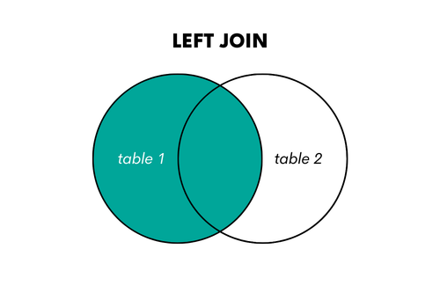
LEFT JOIN (LEFT OUTER JOIN)
Returns all rows from the left table, and matched rows from the right. If no match, right side has NULL.
Use to include all records from main table, even if not related.
SELECT column_name(s) FROM table1 LEFT JOIN table2 ON table1.column_name = table2.column_name;

Slide 14
student_id | name
1 | Raj
2 | Simran
3 | Ayaan
4 | Neha
student_id | course
1 | Python
2 | Java
4 | Web Dev
5 | C++
Result Table
name | course
Raj | Python
Simran | Java
Ayaan | NULL
Neha | Web Dev

Slide 15
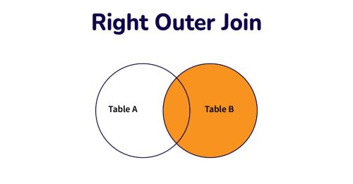
RIGHT JOIN (Right Outer Join)
Returns all rows from the right table, and matched rows from the left. If no match, left side has NULL.
When to Use:
To keep everything from secondary table, even if not related.Example: All products, even if not purchased.
Reverse of LEFT JOIN.Not used often—can usually be swapped by flipping tables in LEFT JOIN.Highlights records that lack corresponding data on the left.
SELECT column_name(s) FROM table1 RIGHT JOIN table2 ON table1.column_name = table2.column_name;

Slide 16
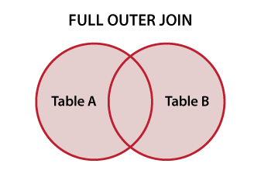
CROSS JOIN
Returns all rows from both tables. Matched rows appear once, unmatched rows get NULLs.
SELECT column_name(s) FROM table1 CROSS JOIN table2;
When to Use:
To combine all data from both tables.
To detect all unmatched records.
For synchronization or merging data.
name | course
Raj | Python
Simran | Java
Neha | Web Dev
Ayaan | NULL
NULL | C++

Slide 17
Self Join
A table joined with itself to compare rows.
SELECT column_name(s) FROM table1 T1, table1 T2 WHERE condition;
When to Use:
To compare students to each other.
For peer or team matching.
In referral or friend systems.
student1 | student2
Raj | Simran
Raj | Ayaan
Raj | Neha
Simran | Raj
Simran | Ayaan
... | ...

Slide 18
Understanding Indexing in MySQL
An index in MySQL is a data structure that improves the speed of data retrieval operations on a database table.
Think of it like a book index – instead of reading every page, you go directly to the topic.
Why Use Indexing?
Faster SELECT queries Efficient data search Reduced data scanning
But: Slows down INSERT, UPDATE, DELETE Takes extra disk space

Slide 19
Basic Syntax of Index
Create index on existing table:
CREATE INDEX index_name ON table_name (column_name);
Drop index:
DROP INDEX index_name ON table_name;
Example Without Index
CREATE TABLE students ( id INT, name VARCHAR(100), age INT );
Query without index:
SELECT * FROM students WHERE name = 'Amit';
This does full table scan
Example With Index
Add index:
CREATE INDEX idx_name ON students(name);
Now the query:
SELECT * FROM students WHERE name = 'Amit';
Uses index lookup → Faster!

Slide 20
Composite Index Example
CREATE INDEX idx_name_age ON students(name, age);
Optimized for queries like:
SELECT * FROM students WHERE name='Amit' AND age=20;
When Not to Use Index
On small tables On columns with many duplicates If table updates are frequent

